Slide 1
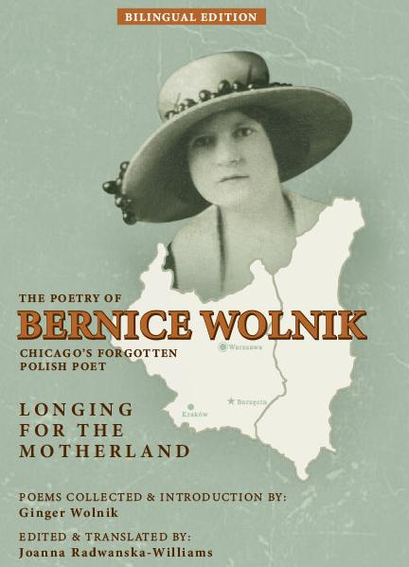

Bronisława Rogóż Wolnik
Longing for the Motherland
Presented by Ginger Wolnik
Polish Museum of America
October 3, 2026
Notes:
"I wrote a book in a language that I don't speak!" Actually, I put together a collection of Polish poetry written by my grandmother, but I never learned Polish! Nevertheless, I'm here today to talk about this bilingual book.

Slide 2
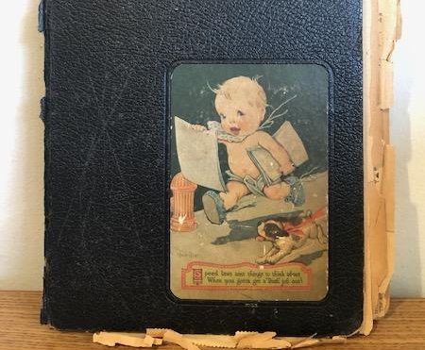
B
Bernice’s Scrapbook
Notes:
These poems were published in various Chicago area Polish newspapers in the 1930s and saved by my grandmother in this scrapbook. My father, Emil Wolnik, inherited his mother's scrapbook and passed it down to me.

Slide 3
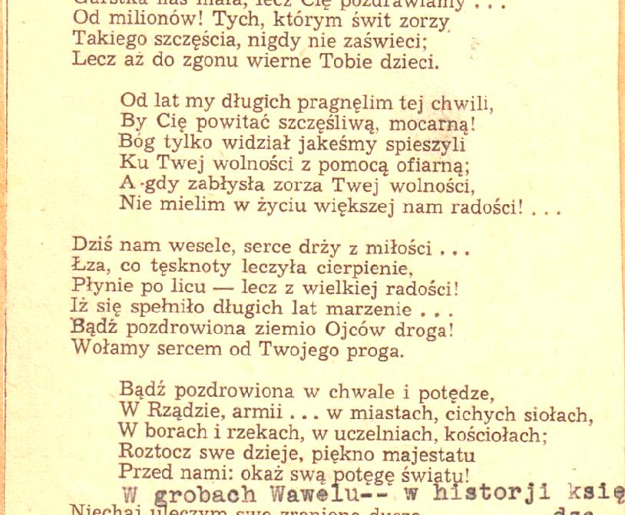
Typical Page
Notes:
Here is a typical example from the scrapbook. Notice the missing line that was manually typed in by my grandmother. Also, unlike many, this was one has a date, 1937 is at the bottom. Over the years, I would occasionally look through the scrapbook, but could never read any of it.

Slide 4
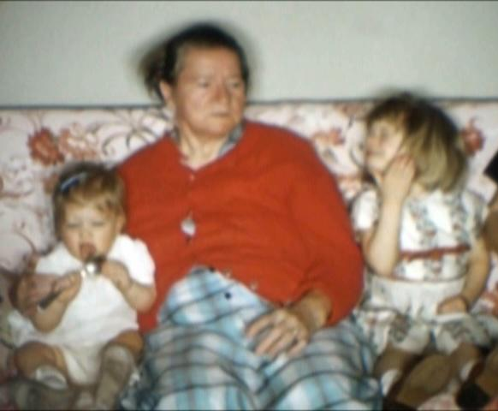
Grandma, Michele,
and me!
Notes:
My grandmother died in 1959 so my memories of her are from photos like this. Here, I'm 3 and my sister Michele is one (Shelly, raise your hand!)

Slide 5
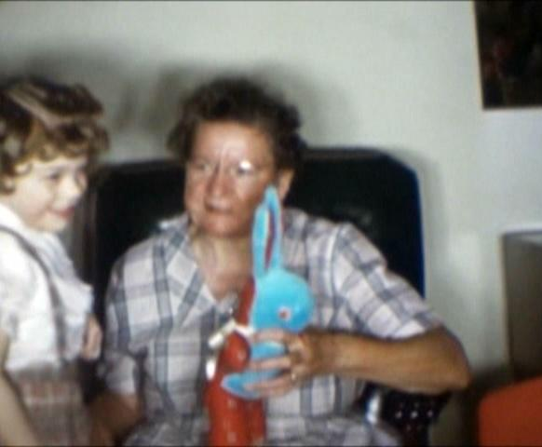
Our last
photo taken together
Notes:
Here is the last photo I have of me with my grandmother, taken a year before she died.

Slide 6
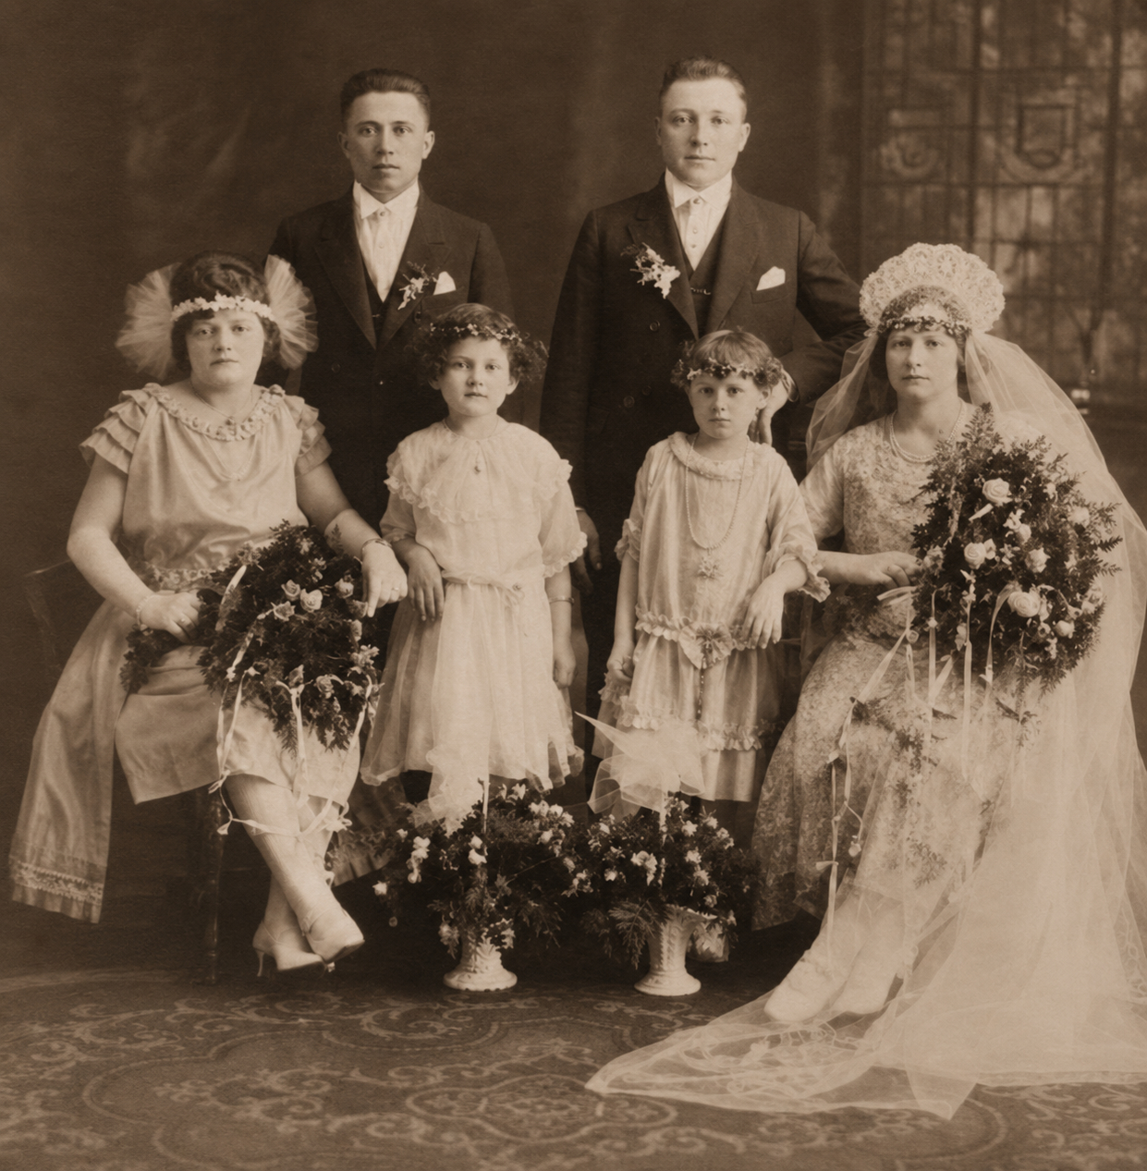
Grandparents Wedding Portrait
(1923)
Notes:
Here is my grandparents 1923 wedding portrait, Bernice is on the far right. When I retired, I had time to do genealogy research and started with family photos like this. My father had already passed, but I did have some family history notes and stories from him. Then I remembered the Scrapbook!

Slide 7
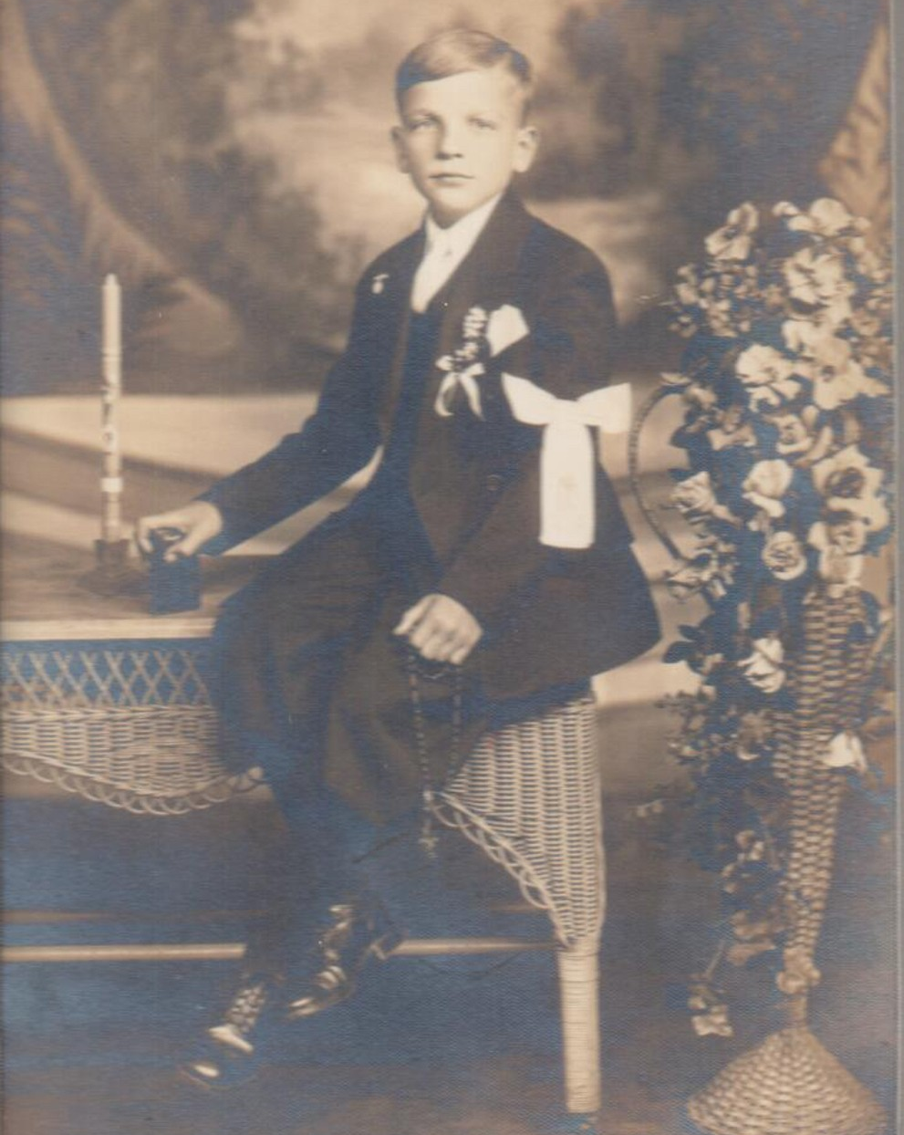
Dad’s
First Communion photo
Notes:
Here is my father's First Communion photo. He was very religious his whole life and told me that influence came from his mother. The only thing I recall him mentioning about the scrapbook poems was their supposed religious themes.

Slide 8
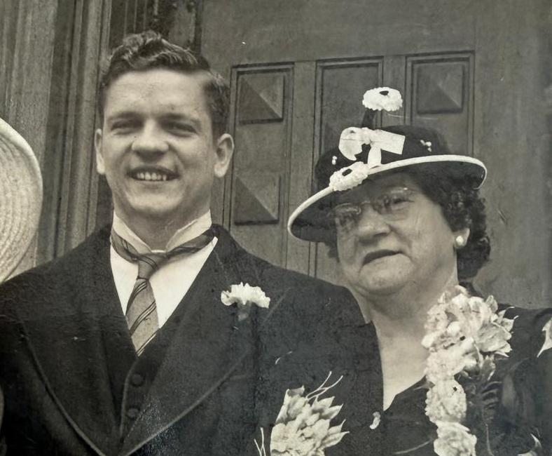
Proud Mother of a College Graduate
(1950)
Notes:
Here is my father with his mother from around 1950. As an only child, they were very close and he lived at home after graduating college.

Slide 9
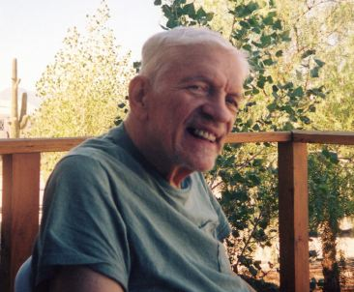
Her little boy—at age 80!
Notes:
Here is the last photo of my father, shortly before he died in 2005. I always thought that he was fluent in Polish, but near the end of his life, his friend from Poland told me that my father spoke with the vocabulary and grammar of a young child! So, I now suspect that he was never able to read these poems himself. Maybe his mother read them to him, he only told me they were religious poems. While there are several with religious themes, I have since discovered that most are not.

Slide 10
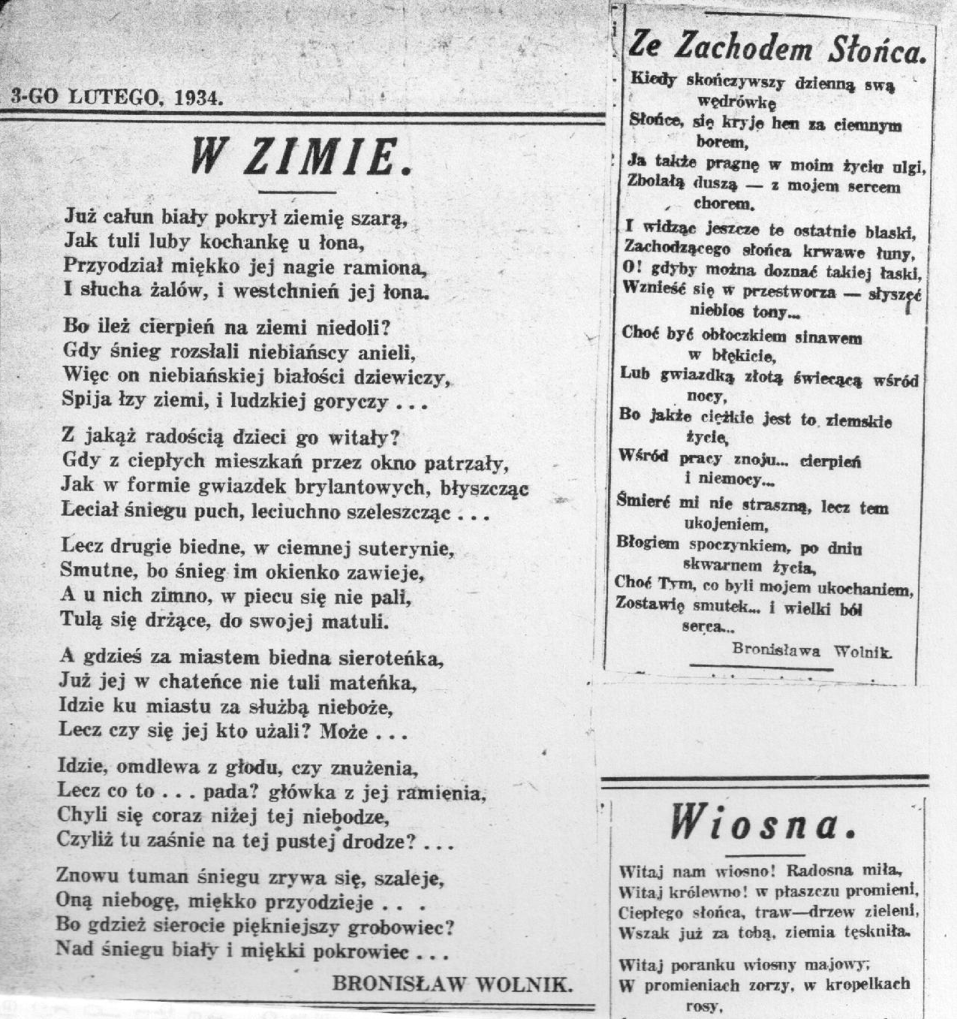
Newspaper clipping of poems
Notes:
Starting in 2020, I scanned the scrapbook and created an inventory of the poems, which I uploaded on my website. Then I searched for a translator so that I could learn what they were about. I eventually found Joanna, who was also able to provide an analysis and annotations! Originally I was just thinking of having a few translated, but the more I learned, I realized that my grandmother had far more depth to her than I ever knew.

Slide 11
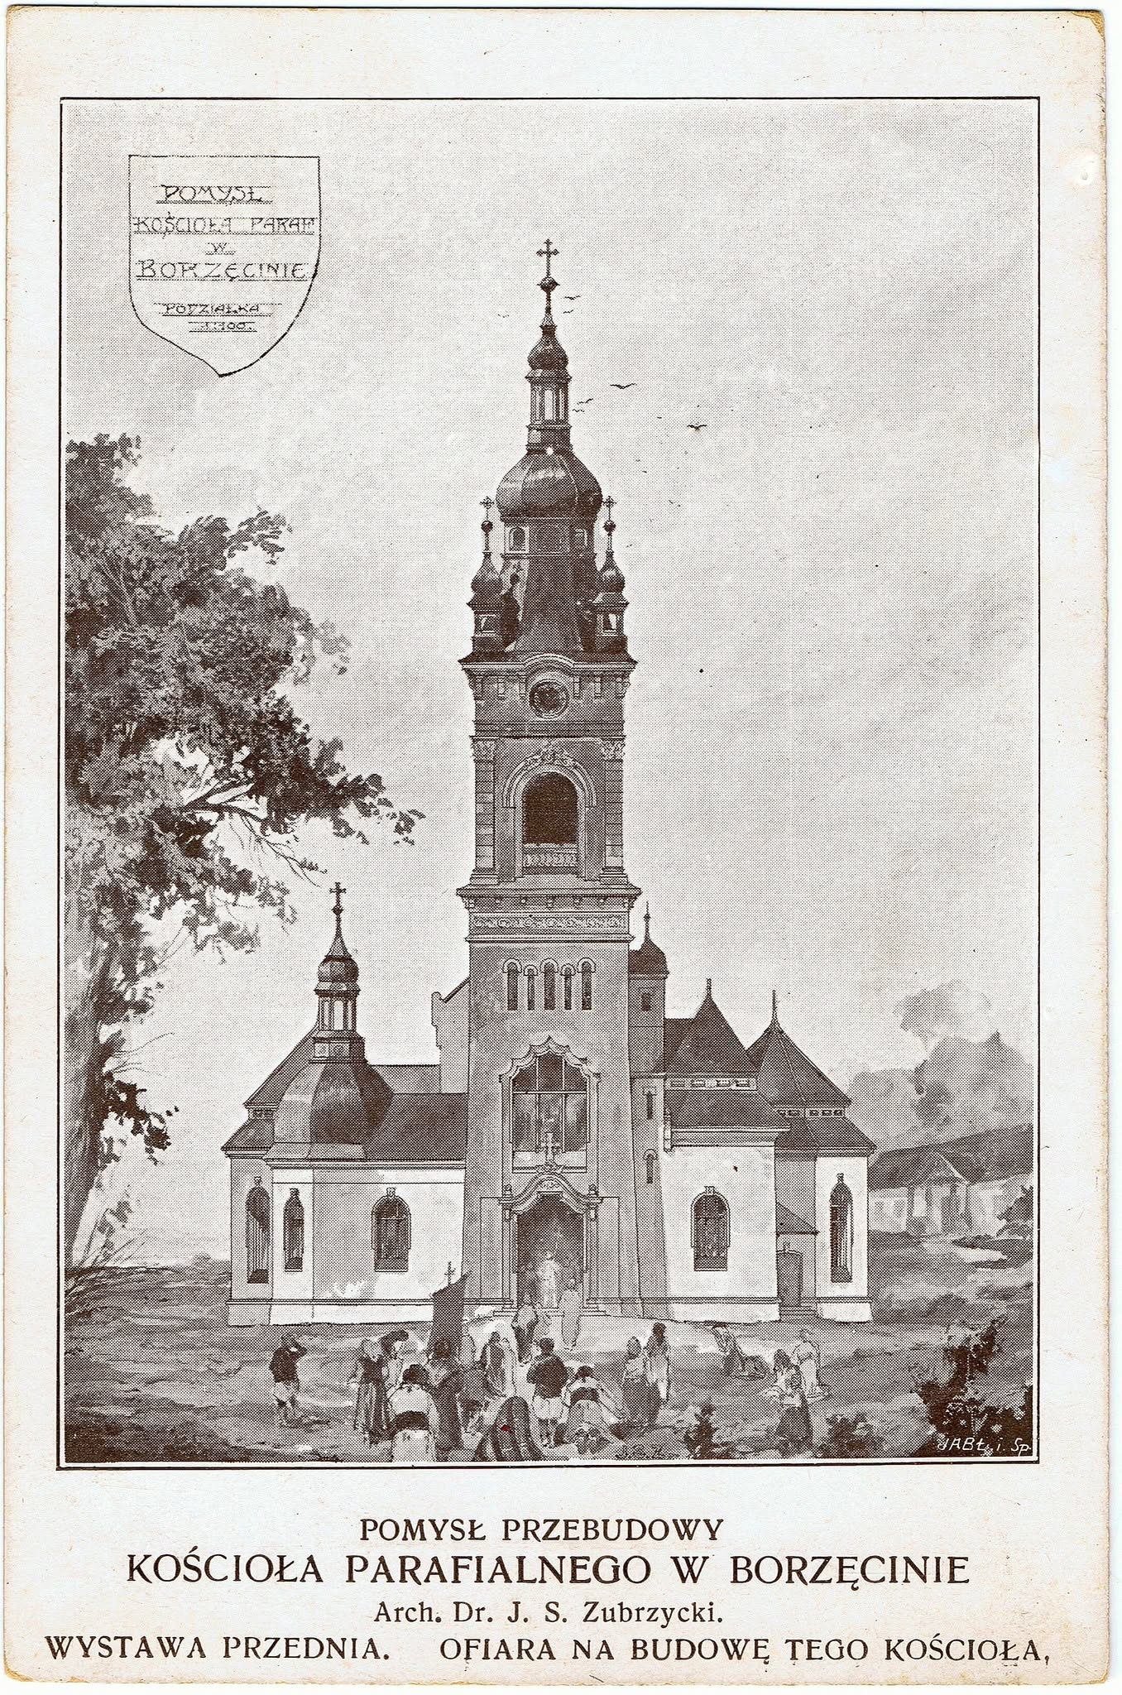
Bronisława Rogóż, born 1897 Borzęcin, Galicia
Notes:
Bronisława Rogóż born in Borzęcin, Galicia in 1897. Here is a drawing of the town church in 1912, which is what it looked like when she was growing up there. She mentions the church and bell tower in the poem “Letter to Dearest Rose”

Slide 12
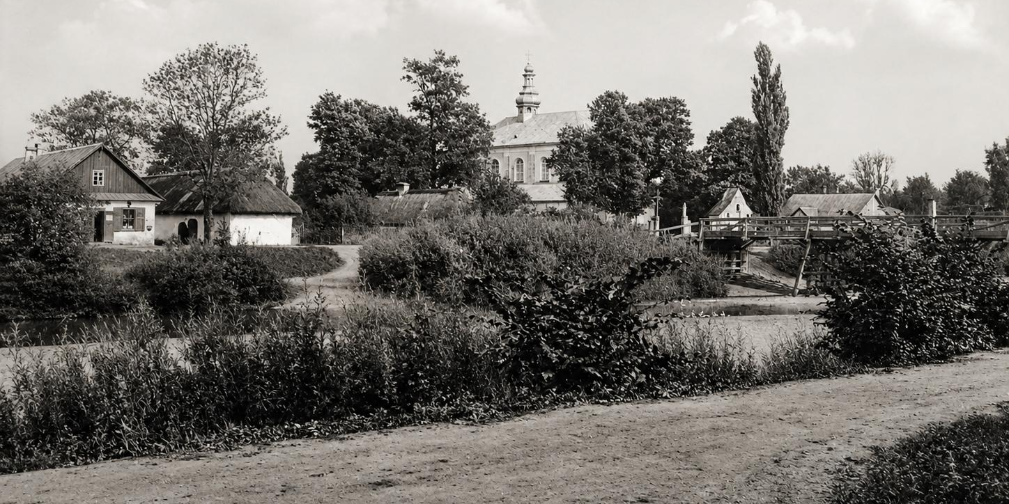
Family home was across the Uszwica river
Notes:
I learned from my genealogy trip in May 2026 that her family home was across the Uszwica river from the church. This photo is from before WW I and shows the bridge as it was when she lived there.

Slide 13
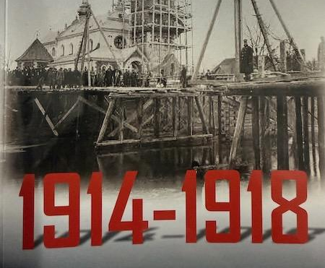
“Ashes”
of The Great War
Notes:
Shortly after the start of WW I, the Austrian army deliberately destroyed the town bridge to slow the advance of the Russian army. Later, the Russians were driven out and the town remained under Austrian control for the rest of the war and they rebuilt the bridge, as shown here. These events must have been traumatic, but only one poem "Ashes" mentions a war.

Slide 14
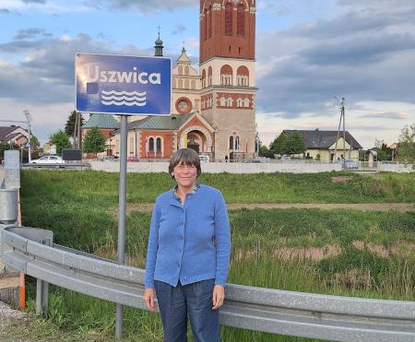
Ginger by the church today
Notes:
Here is a photo of me with the church as it looks today. The current bell tower was completed in the 1920's after Bernice moved to America, but the church she describes in her poems looked like the 1912 version.

Slide 15
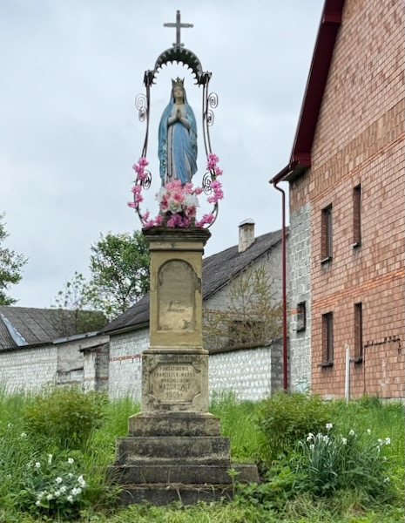
“To the Queen of Heaven and Earth.”
(Borzęcin)
Notes:
Here is a photo I took of a roadside shrine in Borzęcin that was dated 1905, which Bernice must have passed by frequently. Perhaps it inspired her poem "To the Queen of Heaven and Earth."

Slide 16
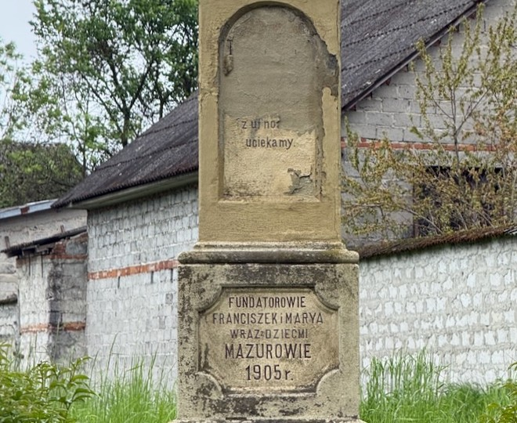
Roadside shrine base 1905 (Borzęcin)
Notes:
The statue was obviously restored, but the base is original. Roadside shrines are still common in Borzęcin and are mentioned in several poems. This was the oldest dated one that I found.

Slide 17
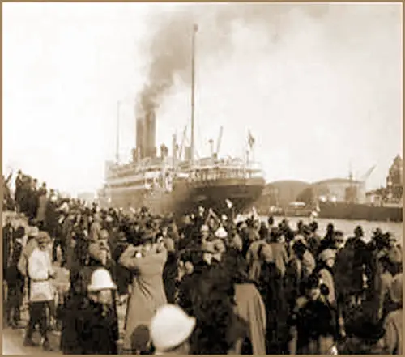
Departing Poland on the steamship, Frederik VIII
Notes:
This is a photo of the steamship Frederik VIII departing Copenhagen in 1925. Bernice sailed on this same ship from Copenhagen in 1921. She later wrote odes to the Baltic Sea and the port of Gdynia.

Slide 18
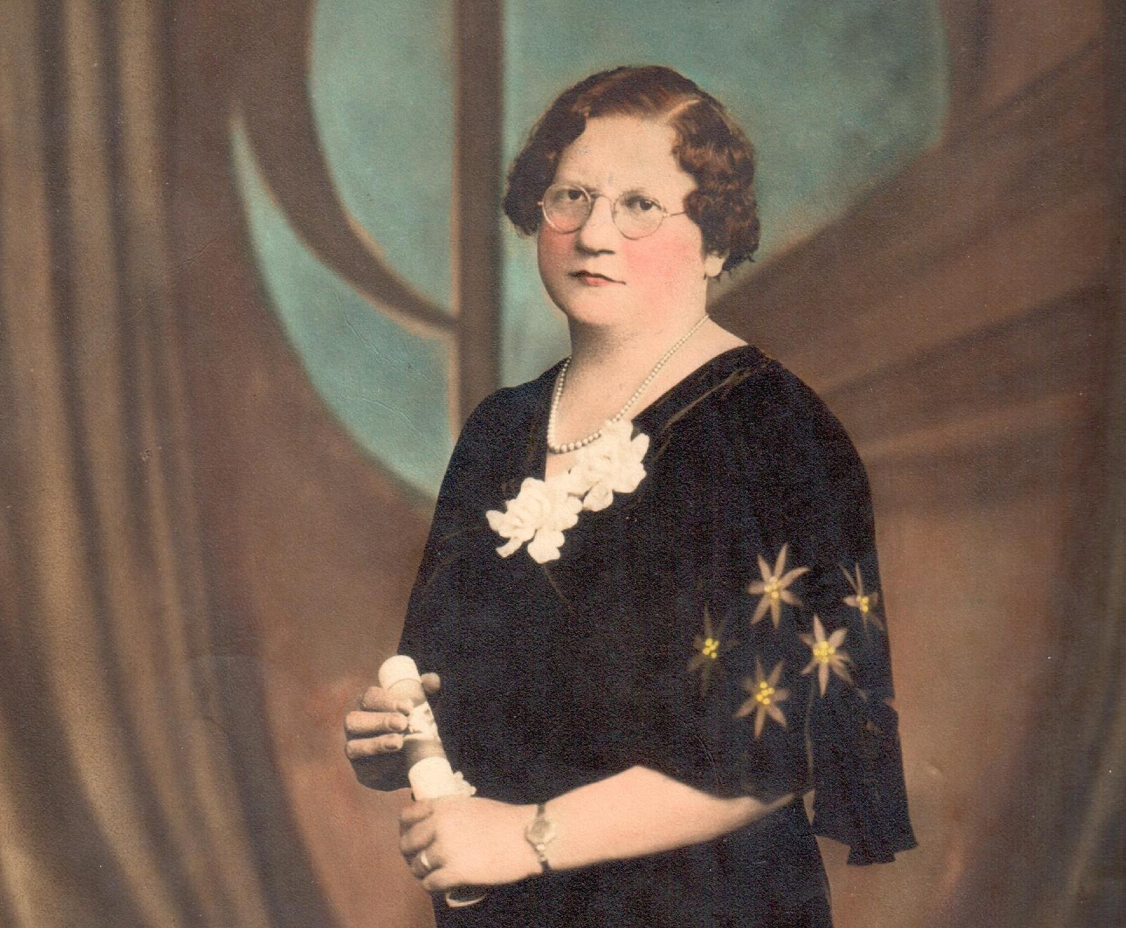
Bernice (1935)
Notes:
Here is a photo of Bernice Wolnik from 1935, when many of the poems were written. She was also a proud member and officer in the Polish Women's Alliance of America during that time and it appears she was posing here with some certificate, perhaps from them.

Slide 19

“Two Banners”
Notes:
In addition to reminiscing about her life in Poland, Bernice wrote many poems about Polish history and politics. Here, the the steamship Frederik VIII Polish Women's Alliance logo shows the sisterhood between the American city housewife and the Polish farm woman. The split banner in the center is the subject of her poem "Two Banners."

Slide 20
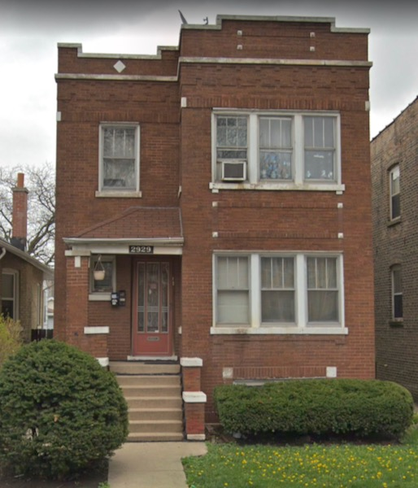
Where the poems were first written
Notes:
Here is a current Google street view of her house from the mid 1930's, when most of her known poems were written. (2929 Harding, Chicago)

Slide 21
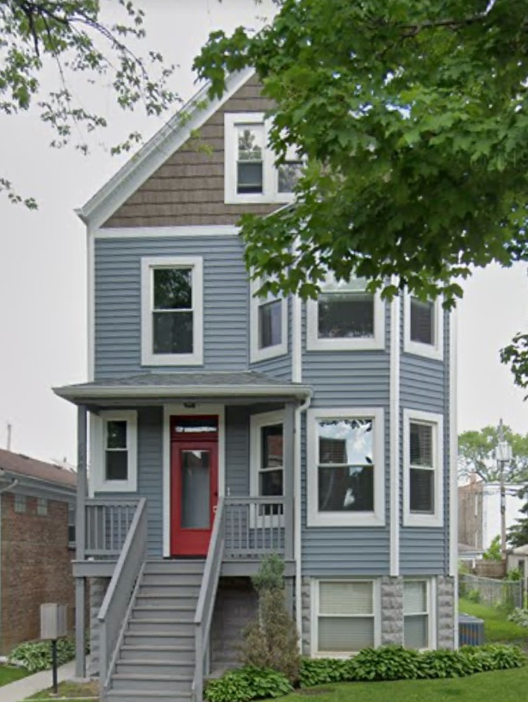
Sweet Home, Chicago
Notes:
Here is a current Google street view of her house from 1938-1942, when she transitioned from poetry to political activism. (3317 Hamlin, Chicago)

Slide 22
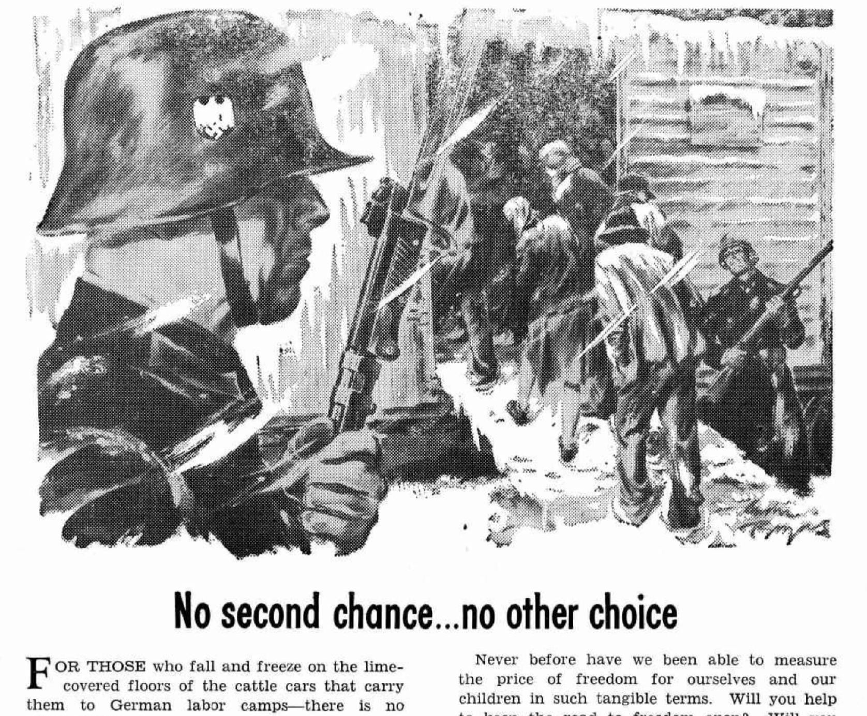
“The Martyrdom of Poland”
Notes:
Her last known poem, The Martyrdom of Poland, was published in November 1939 and is the last poem in the book. This slide shows an ad for war bonds in the program for the 1943 annual convention for the Polish Women's Alliance of America. The Poles in America were acutely aware of the atrocities being committed in Poland at that time.

Slide 23
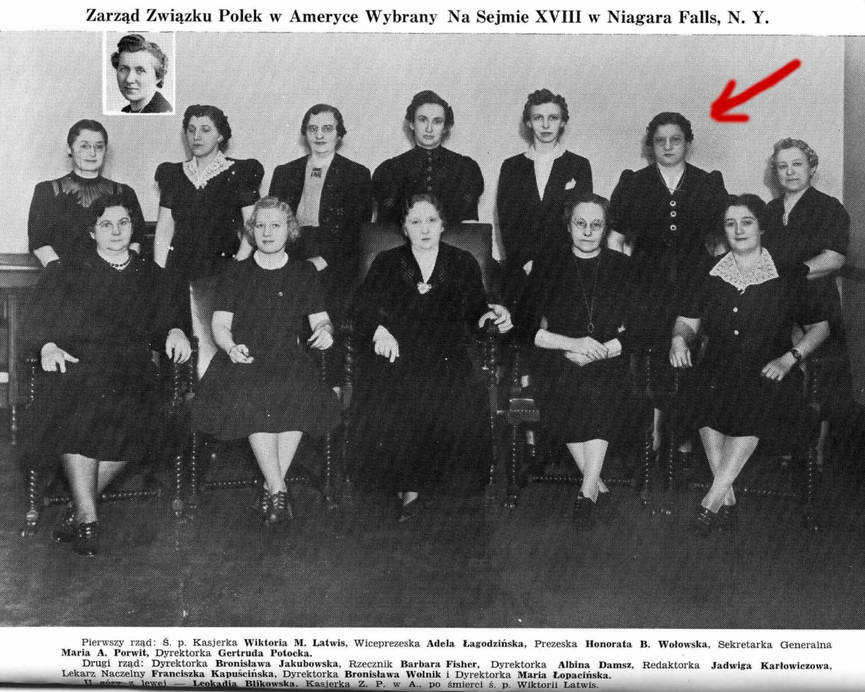
Polish Women's Alliance
Convention, 1942
Notes:
Bernice attended the 1942 annual convention. She might have been too discouraged by the war to write poetry, because the war undid all the progress her poems had celebrated about Poland becoming a country again after the years of partition.

Slide 24
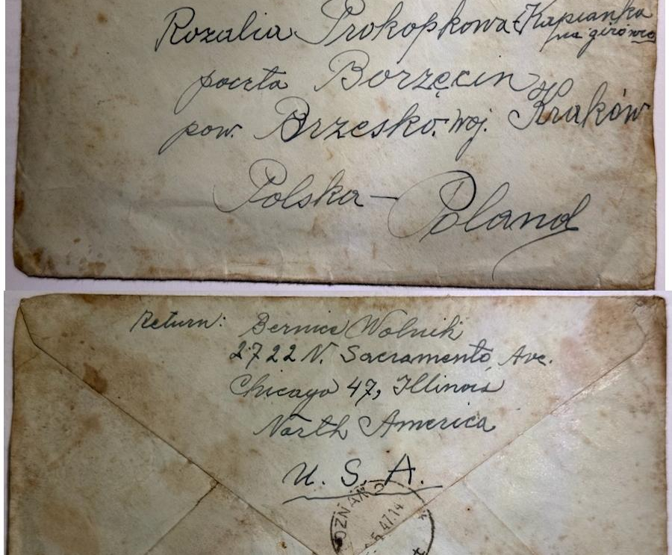
"Letter to Dearest Rose"
Notes:
An amazing discovery from my May trip to Borzęcin was this 1947 letter that Bernice wrote to Rosalia Prokopkowa that was given to me by Rose's granddaughter. This solved the mystery of who was Rose in the poem "Letter to Dearest Rose"! While not the same letter as the poem, there was enough other personal information in it to confirm their relationship.

Slide 25
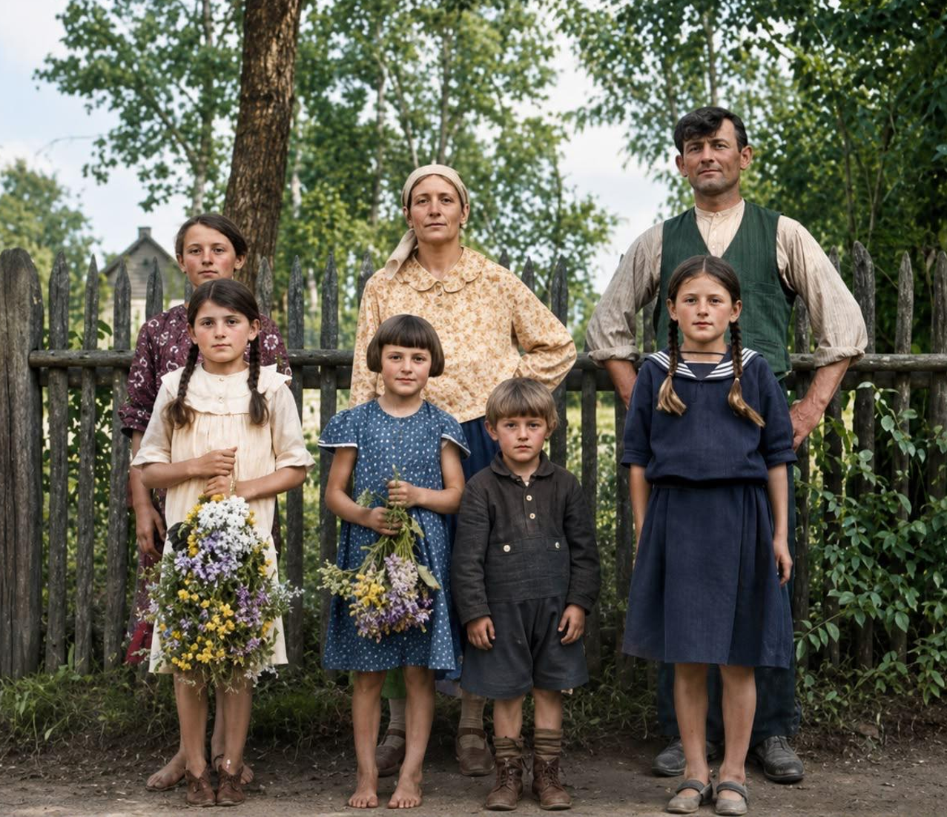
The Karaś Family of Borzęcin, Galicia
Notes:
Here is an AI colorized and enhanced version of the only photo of Bernice's family in Poland, the original version is on page 106 of the poetry book. My father's story of the family was incomplete, but my genealogy trip this past May gave me the names and birthdates of everyone! This photo was an important connection because none of the descendants in Poland have ever seen a photo of their grandfather, Stefan Karaś (back right.) One poem (Letter to Dearest Rose) mentions Bernice's sister, who is in the center back. Notice the house in the background.

Slide 26
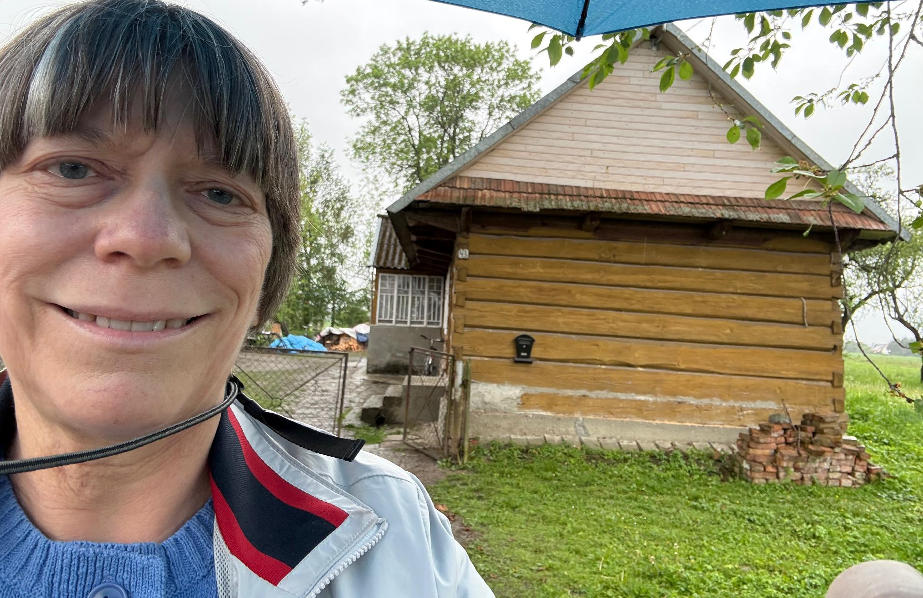
Homecoming: Borzęcin, 2026
Notes:
Ginger visiting the family home in Borzęcin in 2026!

Slide 27
Thank You!
For further information, contact
Ginger Wolnik
ginger@wolnik.us

